Slide 1

Mizan (ميزان)
Software Engineering Project — BCS 202
Team:
Mishal Al-jumaih (Scrum Master),
- (UI/UX),
-(Backend & DB)
Supervisor: -
Topics to be Covered
Project Foundations: Background, Problem Statement, User Story, and System Scope.
Project Planning: Agile Timeline, Iterative Sprints, and Milestones.
System Design & UMLs: MVC Architecture, Database Integrity, Use Case, and Behavioral Diagrams.
Testing Approach & Planning: Black-Box (Playwright Automation) and White-Box Strategies.
Live Demo: System Execution, Security Evidences, and Key Module Walkthrough.

Slide 2

Background
Too Many Tools: Students and freelancers struggle because their data is scattered. They use one app for money, one for tasks, and lose their warranty papers.
The Need: People need a single, simple place to manage their daily life.
Mizan: A unified website that brings everything together in balance.
Objectives
All-in-One Dashboard: Build one system that connects finances, tasks, and file storage.
Strong Security: Protect user accounts and data from any hacking attempts.
Automated Testing: Test every button and feature automatically to ensure zero mistakes.

Slide 3


User Story
The Problem Statement
“As a university student or busy freelancer, I want one secure place to manage my money, tasks, and warranties, so I can stop feeling overwhelmed and take full control of my life.”
Scattered Tools:
People use many different apps (one for money, one for tasks) which causes confusion.
Lost Information:
Paper receipts and important warranties get lost or expire without the user knowing.
Market Gap:
Current apps are either too complicated (like big company software) or too basic (like simple phone notes).
Unified Dashboard:
We need a single place that brings tasks and finances together to save time.
Secure Storage:
A safe digital vault to keep important files and track expiration dates automatically.
Simplicity & Balance:
A system designed specifically for students and freelancers that is easy to use but very effective.

Slide 4
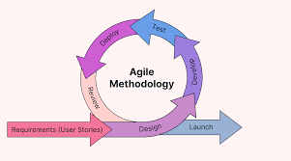
Project Plan & Agile Lifecycle
Initiation
Auth
Core Features
Vault Sys
Planning
Feb 16
Feb 23
Mar 02
Mar 09
Mar 23
SRS Doc
Reports
SDS Doc
QA/STP
Launch
Apr 05
Apr 20
Apr 30
May 15
May 20

Slide 5
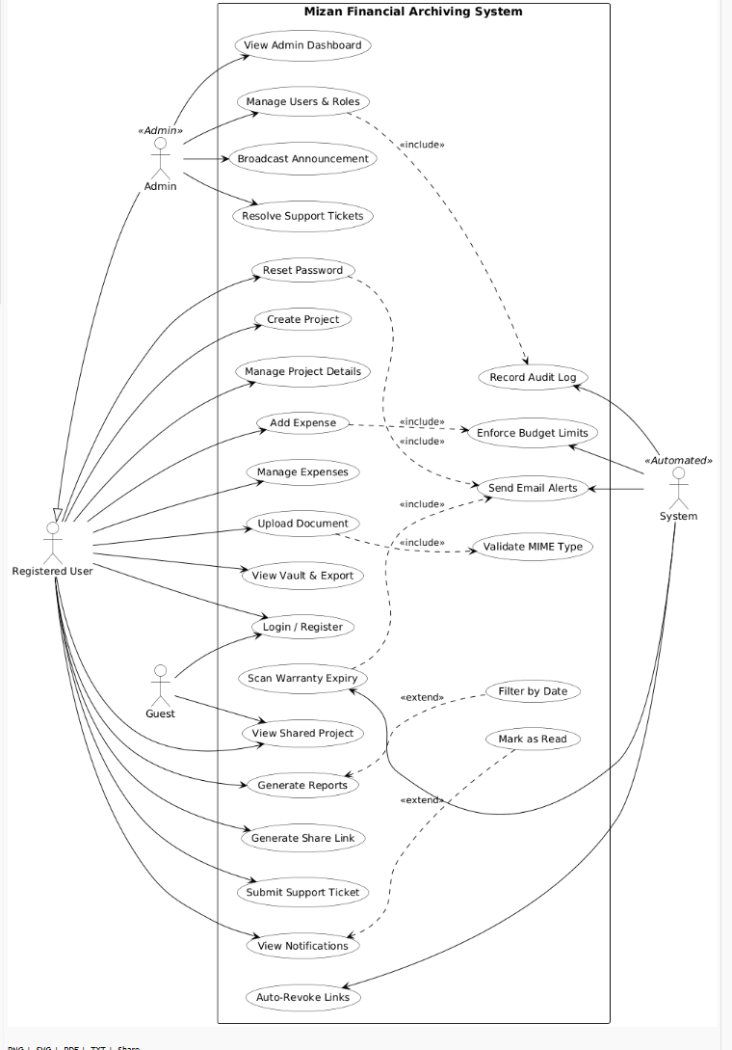
System Actors
Registered User:
Admin:
Guest:
Automated System:
The primary actor (student/freelancer) who manages projects, expenses, and documents.
Responsible for managing users, resolving support tickets, and broadcasting announcements
External user who can only view shared projects via secure links.
Background actor responsible for enforcing budget limits, sending email alerts, validating MIME types, and recording audit logs.
Financial & Project Management: Creating projects, adding/managing expenses, and generating financial reports.
Document Vault Operations: Uploading documents with automated MIME validation and scanning warranty expiries.
Collaboration & Support: Generating secure share links (with auto-revoke capability) and submitting/resolving support tickets.
System Integrity: Background processes that strictly enforce rules like budget limits and audit logging (<<include>> relationships).

Slide 6





Non-Functional Requirements
System Security
Optimized Performance
Architectural Scalability
Ensuring high-speed interactions and seamless visual feedback.
Engineering a foundation that grows with user expansion.
Establishing a zero-trust baseline to protect user financial assets.
60 FPS Rendering: Smooth UI transitions.
MVC Pattern: Decoupled logic for expansion.
Bcrypt Hashing: Secure credential storage.
CSRF Guards: Token-based session protection.
LCP Under 0.7s: Near-instant content loading.
Indexed MySQL: High-volume data retrieval.
PDO Statements: Prevention of SQL Injection.
Modular API: Easy integration of new modules.
Smart Polling: 60s intervals for background sync.
Brute-Force Lockout: Automated account protection.
RESTful Logic: Stateless backend communication.
Chart.js Optimization: Real-time financial viz.

Slide 7
System Architectural-MVC
Mizan is built using the MVC (Model-View-Controller) pattern, ensuring clean separation of concerns and maintainability. The architecture supports secure session management, dynamic UI rendering with Chart.js for visual reports, and automated notification polling at 60-second intervals.
Tech Stack
Backend: PHP
Database: MySQL(phpMyAdmin)
Frontend: HTML / CSS / JavaScript
Charts: Chart.js integration
Database Design & Integrity
Database Design & Integrity
Relational Logic & Constraints: Enforced using strict Foreign Keys and CASCADE rules to maintain flawless data consistency across all system tables.
Financial Precision Engineering: Standardized the DECIMAL(12,2) data type for all monetary fields to completely eliminate floating-point calculation errors during financial tracking.
Structural Data Protection: Integrated database layers tightly with PHP PDO Prepared Statements to safely isolate data processing from input vulnerabilities.
The MVC pattern separates data logic (Model), user interface (View), and application control flow (Controller) for clean, maintainable code
PDO (PHP Data Objects) :is the core security tool used to ensure Mizan’s database is completely locked down against data breaches
.

Slide 8
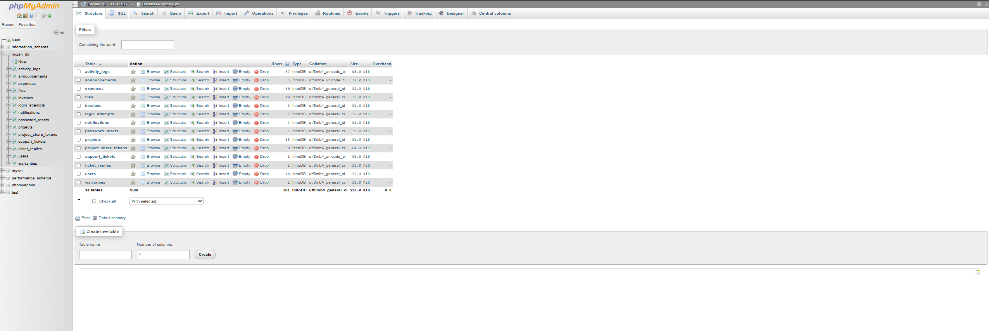
Data Flow
ERD & MySQL
What is phpMyAdmin?
phpMyAdmin is a free, web-based software tool written in PHP that provides a graphical user interface (GUI) to handle the administration and management of MySQL.
How it Relates to Mizan: In this project, phpMyAdmin serves as the primary visual control center for our Data Access Layer.
As shown in the image,
it allows us to efficiently manage the mizan_db database and its 14 DB tables (such as users, projects, and expenses).
Because our web application is built on a PHP and MySQL stack, this tool is essential for executing database operations
, enforcing structural constraints, and monitoring data integrity without needing to rely exclusively on raw command-line SQL queries.

Slide 9
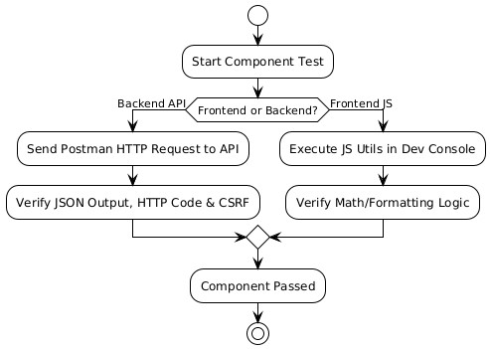
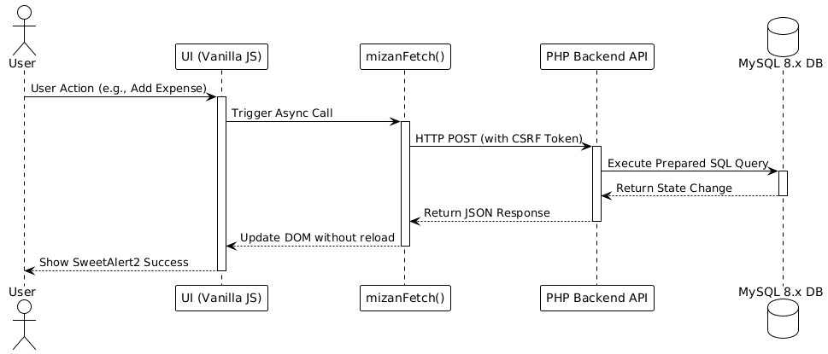
UML Behavioral Diagrams
Activity & Sequance Diagrams
Figure : Integration Testing (5.2)
Figure : Component Testing (5.1)
MVC Data FlowObjective: To map the step-by-step data cycle across the 3-tier architecture.
Frontend Trigger: User actions in the UI invoke the custom mizanFetch() asynchronous function.
Backend API: The PHP layer securely receives the HTTP POST request, validates the CSRF token, and executes a prepared SQL query.
Seamless Update: MySQL returns the state change, allowing the UI to dynamically update and display a success message without reloading the page.
Description: Isolated Component Testing Strategy
Objective: To independently test backend and frontend modules prior to integration.
Backend Path: Utilizes Postman to send HTTP requests to the API, ensuring JSON outputs, status codes, and CSRF tokens are correct.
Frontend Path: Utilizes the browser's Developer Console to execute JavaScript utilities, validating internal math and formatting logic.
Outcome: Both paths must pass their specific verifications for the component to be approved.

Slide 10





Testing Approach & Strategic Planning
Three-Layer Testing Strategy
Software Test Plan (STP)
COMPONENT TESTING
A comprehensive STP was developed to ensure functional correctness, security, and high performance across all 12 system modules.
Individual PHP functions and API endpoints tested in isolation to verify internal business logic.
26
100%
Defined Test Cases
Feature Coverage
INTEGRATION TESTING
Validating DB connections, session sharing, and seamless data flow across system modules.
TEAM ROLES
SECURITY TESTING
Mishal: Test Lead & QA Automation
End-to-end verification of CSRF tokens, SQL Injection prevention, and Brute-force lockout logic.
Alwaleed: Database & API Integrity
Abdullah: UI/UX & Frontend Validation

Slide 11
10A & 10B: Testing Methodologies
10A. Black Box Test (T-01)
10B. White Box Test (T-20)
Test Name | User Registration - bcrypt hash
Requirement | FR-01 (User Authentication)
Technique | Black-Box Testing
Steps | Navigate to register.php, enter valid credentials, submit.
Expected | Redirect to login.php, password stored as bcrypt hash.
Result | ✅ Success - Abdullah Radhi
Test Name | Client-side XSS Prevention
Requirement | NFR-04 (Security)
Technique | White-Box Testing (Static Code Analysis)
Steps | Audit main.js for innerHTML; verify textContent/createElement.
Expected | No innerHTML usage; safe DOM manipulation.
Result | ✅ Success - Alwaleed Al-zahrani
Logic Verification: Validating internal code structure (White-Box) alongside functional user paths (Black-Box).

Slide 12


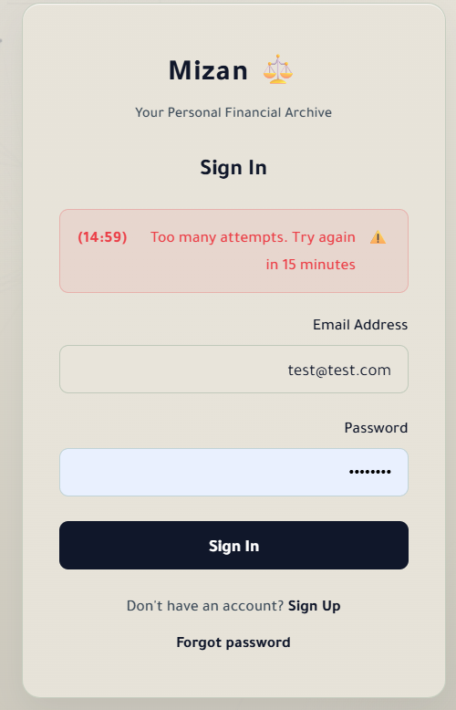
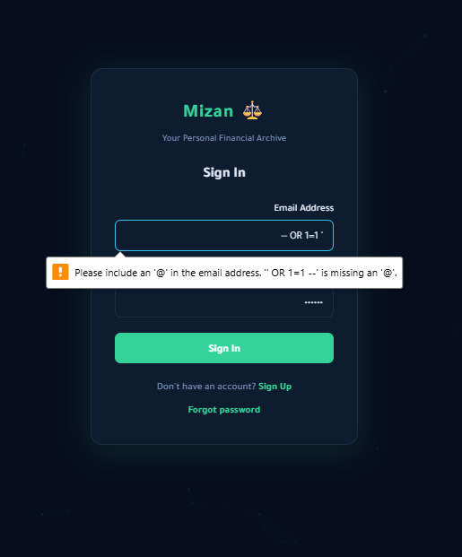
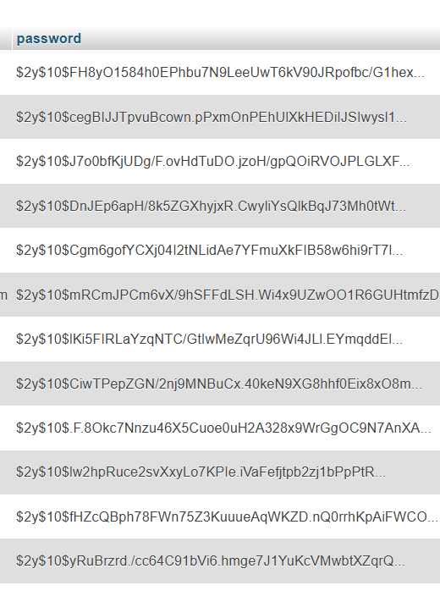
Security Test Evidences
Brute-Force Protection
Password Hashing
SQL Injection Prevention
15-minute lockout timer activates after 5 failed login attempts.
All credentials stored as high-entropy bcrypt hashes (Cost 10).
SQL Injection payloads were successfully blocked via PDO prepared statements throughout the application.
Status: ✅ Payload Successfully Blocked

Slide 13
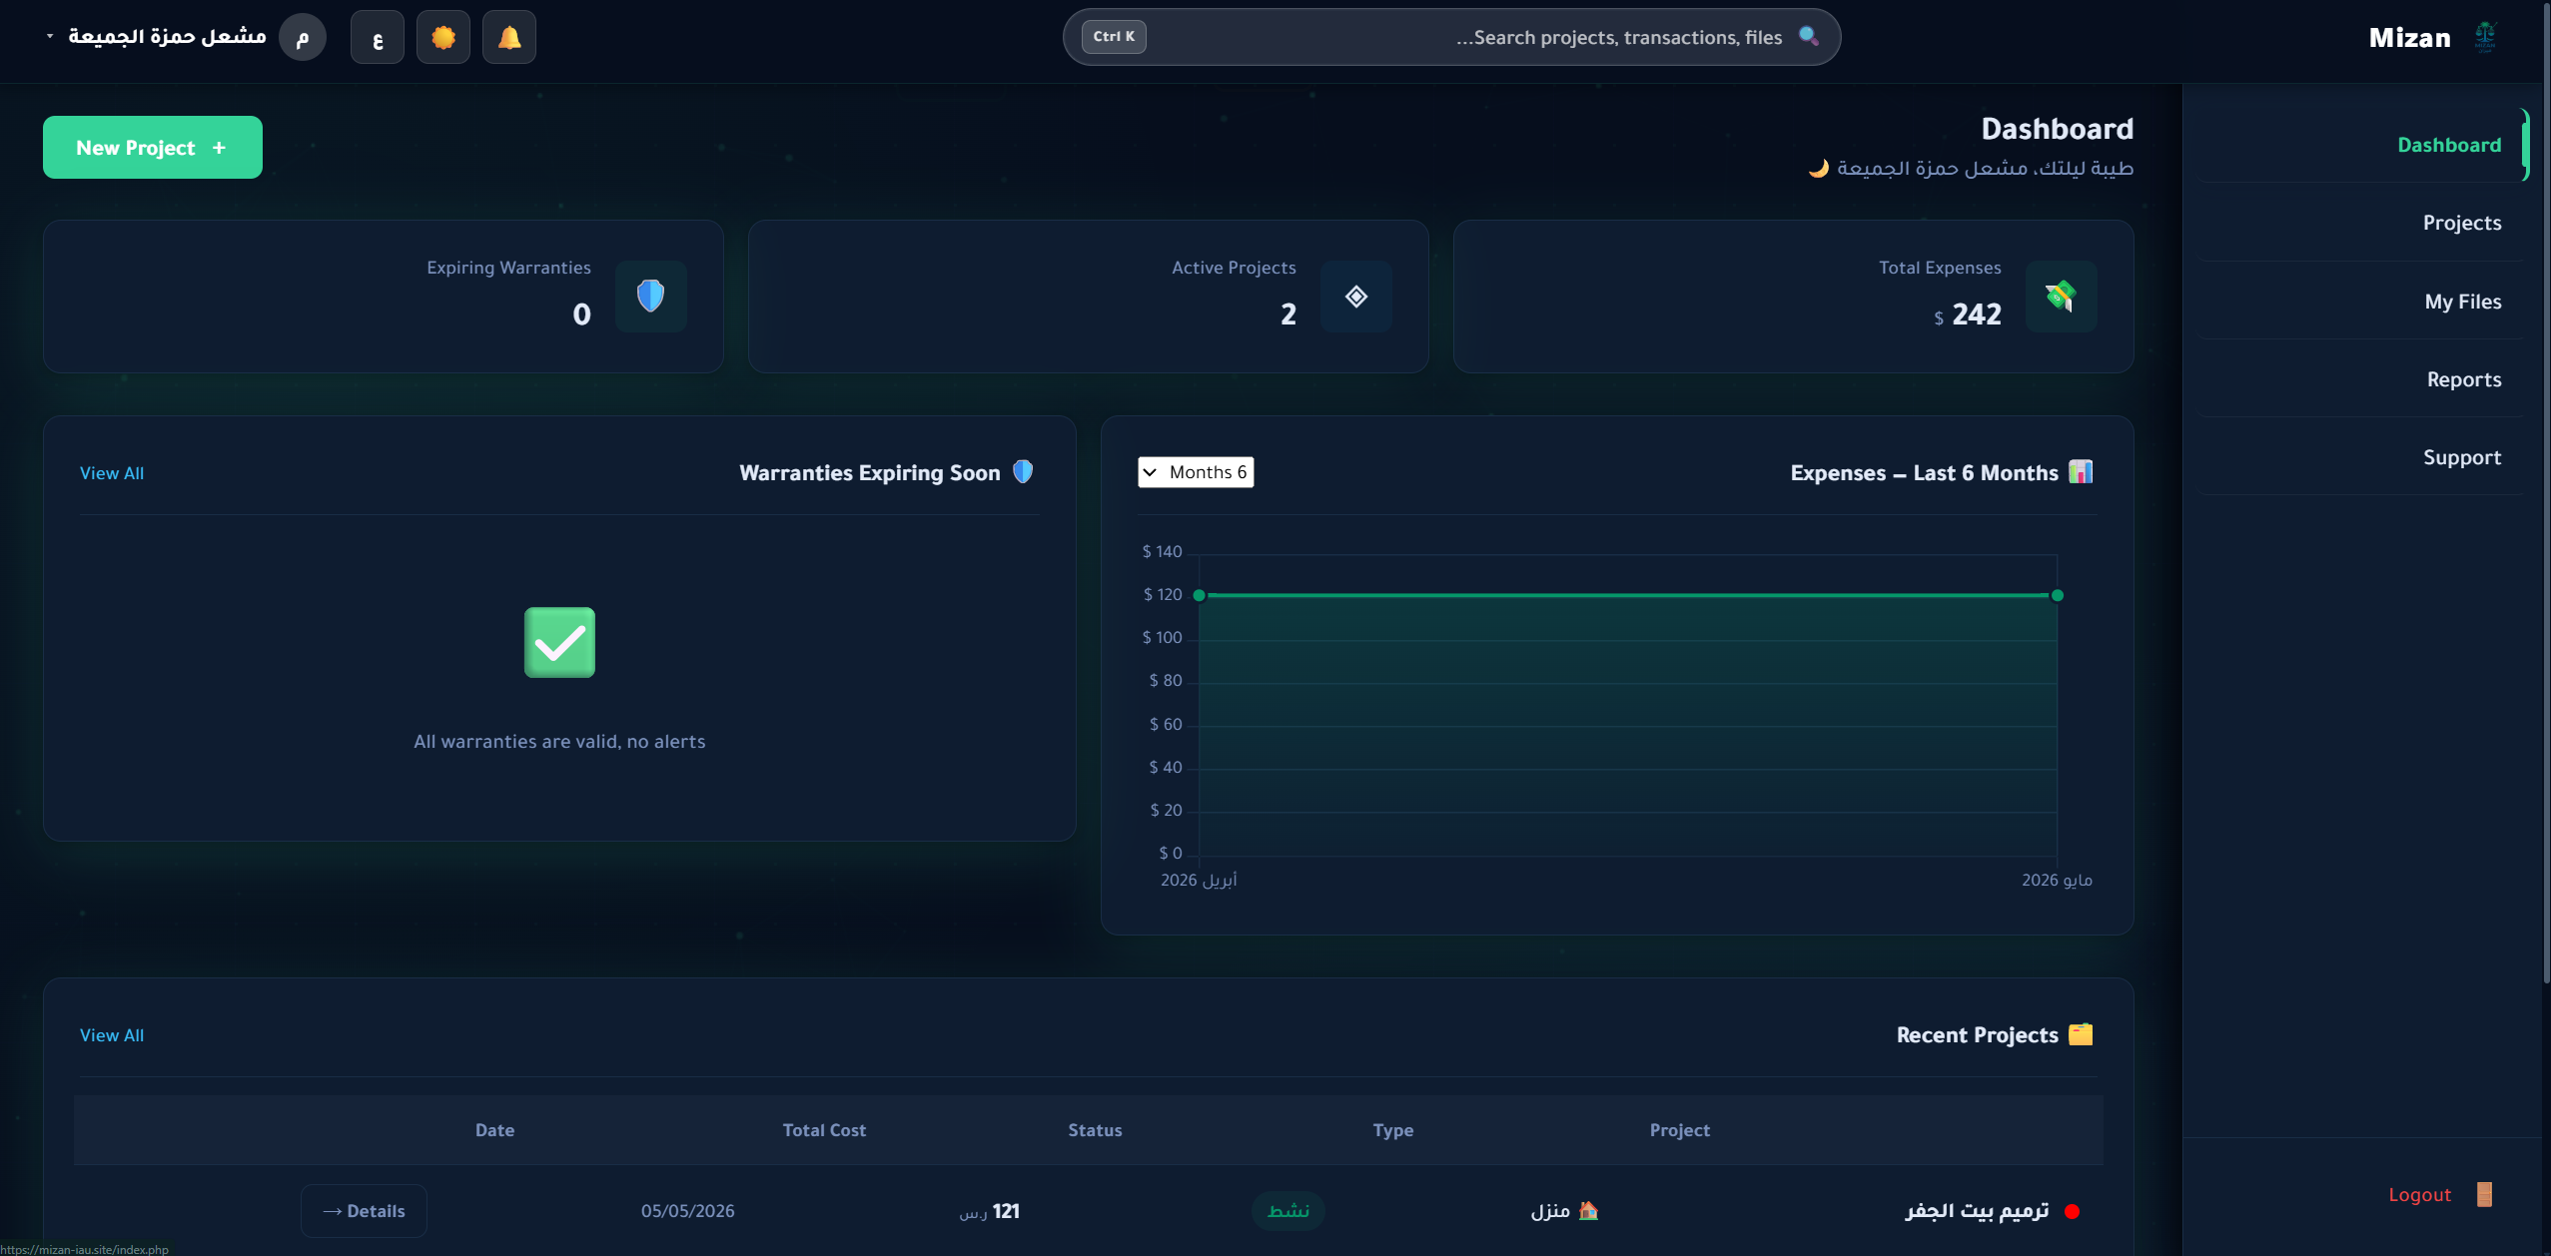
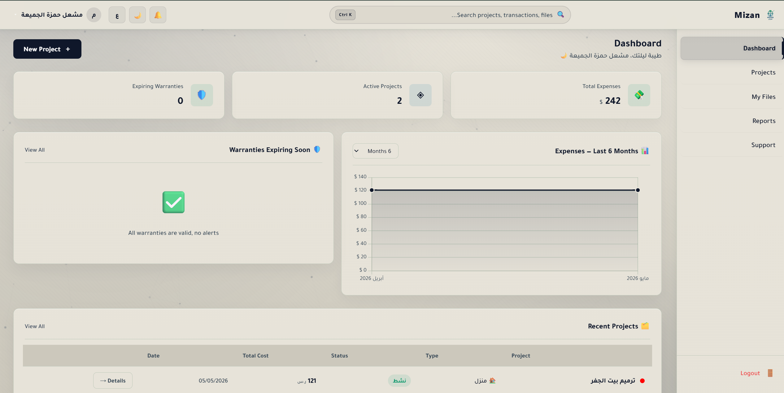
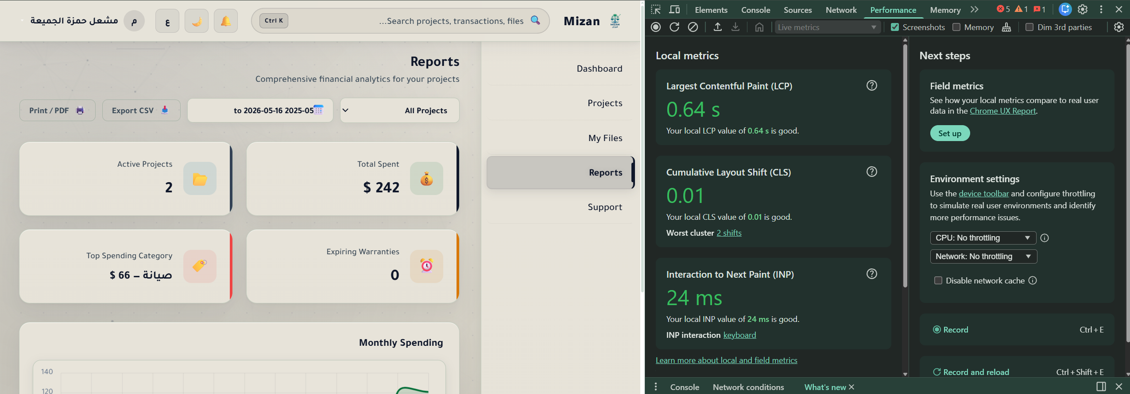
UI & Performance Evidences
Full Localization
Complete Arabic RTL and English LTR support implemented across all views with persistent session handling.
Dark / Light Mode
Dynamic theme switching implemented without layout shifts or functionality loss.
High Performance
Mizan renders at a consistent 60 FPS with an LCP of 0.64s, exceeding academic benchmarks.
Result: 100% Compliance with SRS/SDS Non-Functional Requirements

Slide 14

Live demo & Questions
Thank you for your time and attention. The floor is now open for any questions regarding Mizan's architecture, testing methodology, or future roadmap.

